Slide 1

The Software Development Life Cycle
CS411

Slide 2
The software process
A structured set of activities required to develop a
software system.
Many different software processes but all involve:
  Specification – defining what the system should do;
  Design and implementation – defining the organization of the system and implementing the system;
  Validation – checking that it does what the customer wants;
  Delivery – releasing to product to the customer
  Evolution – changing the system in response to changing customer needs.
A software process model is an abstract representation of a process. It presents a description of a process from some particular perspective.

Slide 3
Bottom line
Software development is a planned activity
We use process to both manage the software development lifecycle (SDLC) activities and to improve the process itself
Each company uses its own SDLC model but all of them are essentially Define, Design, Develop, Deliver, DMaintain
The differences are often of scale and/or concurrency of activities

Slide 4
Bottom line
Software development is a planned activity
We use process to both manage the software development lifecycle (SDLC) activities and to improve the process itself
Each company uses its own SDLC model but all of them are essentially Define, Design, Develop, Deliver, DMaintain
The differences are often of scale and/or concurrency of activities

Slide 5
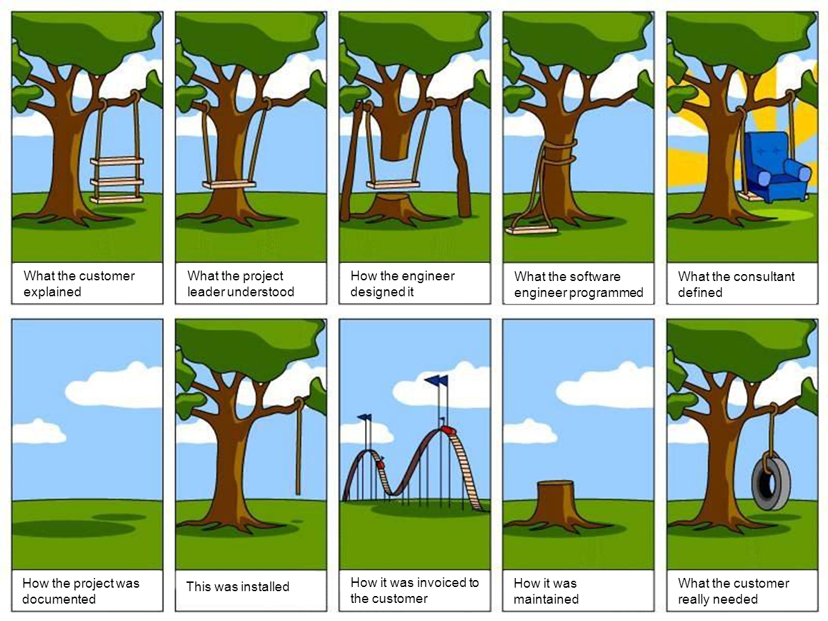

Slide 6
What is software engineering?
“A systematic approach to the analysis, design, assessment, implementation, test, maintenance and re-engineering of software, that is, the application of engineering to software.”
Software engineering encompasses methodologies and principles related to
Conceiving | Building (meh)
Communicating | Designing
Specifying | Testing
Designing | Maintaining

Slide 7
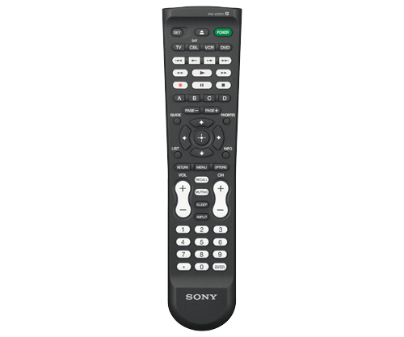
Benefits are good. Features with no benefit are actively bad
Software doesn’t make money. Deployed artifacts make money

Slide 8
RUP: Rational Unified Process
Derived from the work on the UML at Rational
  Booch, Jacobson, and Rumbaugh (1999)
4 Phases:
  Inception
  Elaboration
  Construction
  Transition
Several Iterations in each phase
For each iteration, several parallel activities (workflows)

Slide 9
RUP Phases
Inception
  Establish the business case for the system
  Identify actors and initial use cases
  Initial planning, estimation and schedule
Elaboration
  Understand problem domain
  Requirements model (use case model)
  Overall system architecture
Construction
  System design, object design, programming and testing
  Develop a working software system ready to deliver to users
Transition
  Deploy the system in its operating environment.

Slide 10
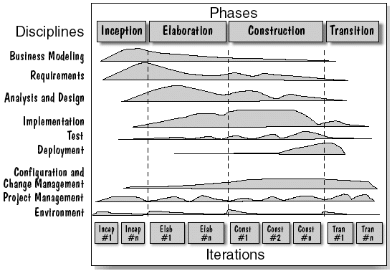
RUP Illustrated
Time
Workflows

Slide 11
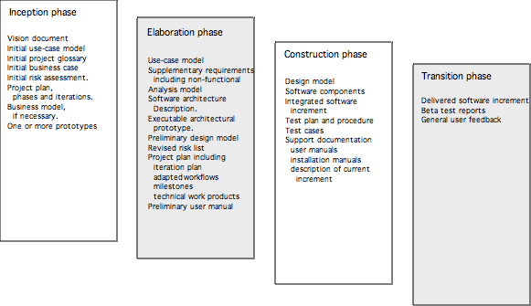
RUP Work Products
12

Slide 12
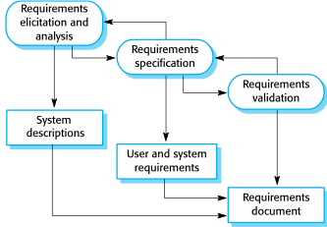
The requirements engineering process

Slide 13
Plan-driven vs agile processes
Plan-driven, or prescriptive, processes are processes where all of the process activities are planned in advance and progress is measured against this plan — they strive for an orderly approach to development.
In agile processes, planning is incremental and it is easier to change the process to reflect changing customer requirements.
In practice, most practical processes include elements of both plan-driven and agile approaches.
There are no right or wrong software processes.

Slide 14
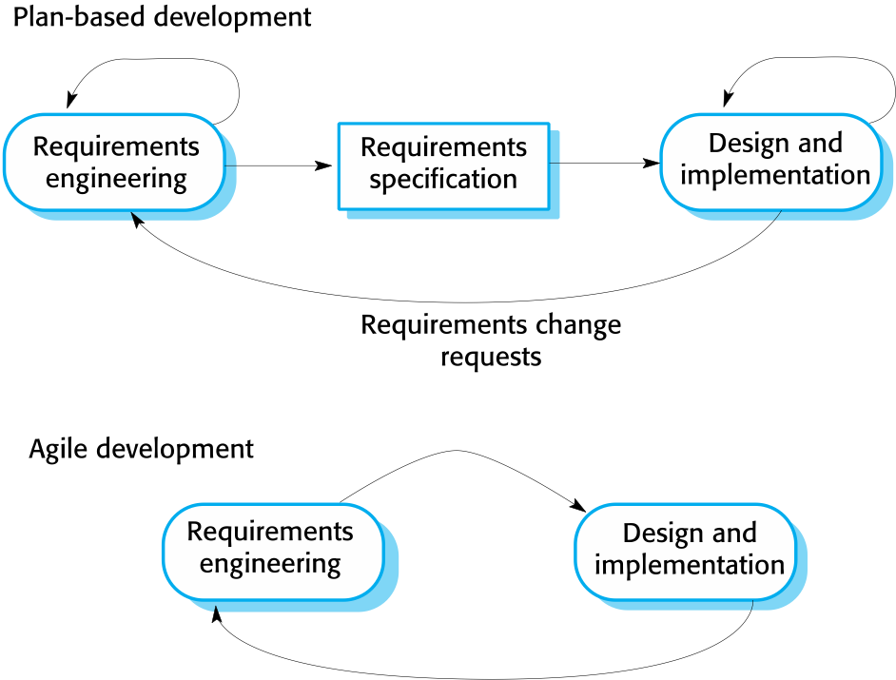
Plan-driven vs agile development

Slide 15
Waterfall Model—2 week decisions every 6 months
Activity-centered view of the software lifecycle
  Define detailed upfront requirements
  Come up with the design that will support the required behavior.
  Implement the required system.
  Integrate and test the components.
Activities are performed in sequence
Described in 1970 by Royce.

Slide 16
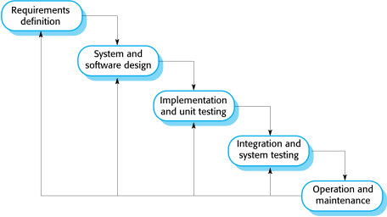
The waterfall model
Define, Design, Develop, Deliver

Slide 17
Waterfall model phases
There are separate identified phases in the waterfall model:
  Requirements analysis and definition
  System and software design
  Implementation and unit testing
  Integration and system testing
  Operation and maintenance
The main drawback of the waterfall model is the difficulty of accommodating change after the process is underway. In principle, a phase has to be complete before moving onto the next phase.

Slide 18
Software process models
The waterfall model
  Plan-driven model. Separate and distinct phases of specification and development.
Incremental development
  Specification, development and validation are interleaved. May be plan-driven or agile.
Integration and configuration
  The system is assembled from existing configurable components. May be plan-driven or agile.
In practice, most large systems are developed using a process that incorporates elements from all of these models.

Slide 19
Problems with the Waterfall (I)
Complete up-front specifications with sign-off
  Research showed that 45% of features created from early specifications were never used—with an additional 19% rarely used [Johnson02].
  Over-engineering, a study of 400 projects spanning 15 years showed that less than 50% of the code was actually useful or used [CLW01].

Slide 20
Problems with the Waterfall (II)
Late Integration and Test
  The waterfall pushes this high-risk and difficult issues toward the end of the project. Waterfall is called fail-late lifecycle.
Reliable Up-front Estimates and Schedules
  Can not be done when the full requirements and risks are not reliably known at the start, and high rates of change are the norm.
“Plan the work, work the plan” values
  Limited value for high change, novel, innovative domains such as software development.

Slide 21
Waterfall model problems
Inflexible partitioning of the project into distinct stages makes it difficult to respond to changing customer requirements.
  Therefore, this model is only appropriate when the requirements are well-understood and changes will be fairly limited during the design process.
  Few business systems have stable requirements.
The waterfall model is mostly used for large systems engineering projects where a system is developed at several sites.
  In those circumstances, the plan-driven nature of the waterfall model helps coordinate the work.

Slide 22
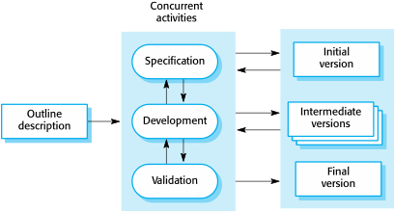
Incremental development

Slide 23
Incremental development benefits
The cost of accommodating changing customer requirements is reduced.
  The amount of analysis and documentation that has to be redone is much less than is required with the waterfall model.
It is easier to get customer feedback on the development work that has been done.
  Customers can comment on demonstrations of the software and see how much has been implemented.
More rapid delivery and deployment of useful software to the customer is possible.
  Customers are able to use and gain value from the software earlier than is possible with a waterfall process.

Slide 24
Incremental development problems
The process is not visible.
  Managers need regular deliverables to measure progress. If systems are developed quickly, it is not cost-effective to produce documents that reflect every version of the system.
System structure tends to degrade as new increments are added.
  Unless time and money is spent on refactoring to improve the software, regular change tends to corrupt its structure. Incorporating further software changes becomes increasingly difficult and costly.

Slide 25
Agile methods—6 month decisions every two weeks
Dissatisfaction with the overheads involved in software design methods of the 1980s and 1990s led to the creation of agile methods. These methods:
  Focus on the code rather than the design
  Are based on an iterative approach to software development
  Are intended to deliver working software quickly and evolve this quickly to meet changing requirements.
The aim of agile methods is to reduce overheads in the software process (e.g. by limiting documentation) and to be able to respond quickly to changing requirements without excessive rework.

Slide 26
The principles of agile methods
Principle | Description
Customer involvement | Customers should be closely involved throughout the development process. Their role is provide and prioritize new system requirements and to evaluate the iterations of the system.
Incremental delivery | The software is developed in increments with the customer specifying the requirements to be included in each increment.
People not process | The skills of the development team should be recognized and exploited. Team members should be left to develop their own ways of working without prescriptive processes.
Embrace change | Expect the system requirements to change and so design the system to accommodate these changes.
Maintain simplicity | Focus on simplicity in both the software being developed and in the development process. Wherever possible, actively work to eliminate complexity from the system.

Slide 27
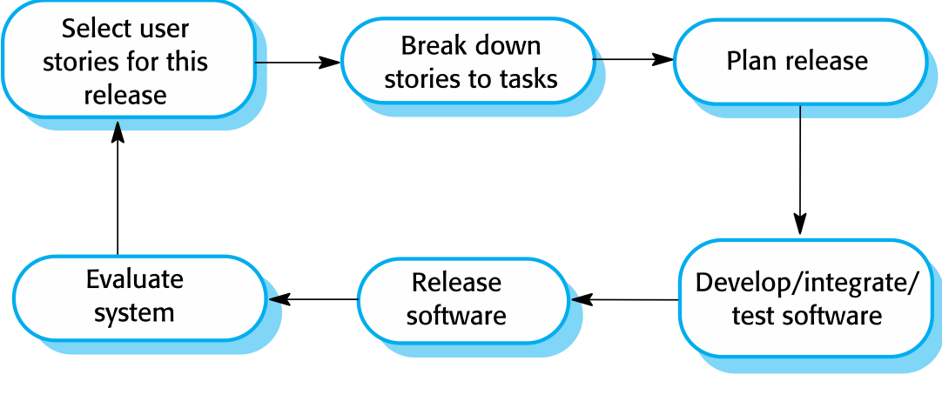
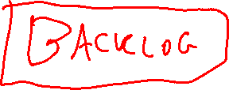
  The extreme programming (XP) release cycle

Slide 28
Scrum
Scrum is an agile method that focuses on managing iterative development rather than specific agile practices.
There are three phases in Scrum.
  The initial phase is an outline planning phase where you establish the general objectives for the project and design the software architecture.
  This is followed by a series of sprint cycles, where each cycle develops an increment of the system.
  The project closure phase wraps up the project, completes required documentation such as system help frames and user manuals and assesses the lessons learned from the project.

Slide 29
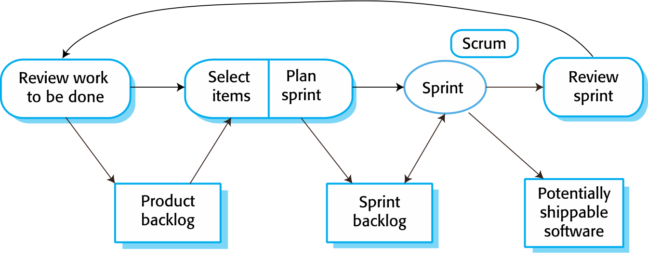
Scrum sprint cycle

Slide 30
The Goal—Scrum
What exactly do I want to have happen?
How will I know if it worked?

Slide 31
The Goal—Scrum
What exactly do I want to have happen?
  Fulfill long term visions quickly and flexibly
  “Have fun”

Slide 32
The Goal—Scrum
What exactly do I want to have happen?
  Fulfill long term visions quickly and flexibly
  “Have fun”
  Never forget:
    you work for money, not pizza
    you don’t work on the weekends except for HARD deadlines
    -> don’t do hackathons

Slide 33
The Goal—Scrum
What exactly do I want to have happen?
  Fulfill long term visions quickly and flexibly
  “Have fun”
  Never forget:
    you work for money, not pizza
    you don’t work on the weekends except for HARD deadlines
    -> don’t do hackathons
How will I know if it worked?
  Good question

Slide 34
The Hierarchy
Theme / Initiative
Epic
User Story
Task
Subtask / Ticket—This is what you log your time against

Slide 35
The Hierarchy
Theme / Initiative
  Make more money off of grid pages Make the grid page experience more delightful
Epic
User Story
Task
Subtask / Ticket—This is what you log your time against

Slide 36
The Hierarchy
Theme / Initiative
  Make more money off of grid pages
Epic
  Make discovery “more fun”
  Better faceting
  Better recommendations
  Something something deep learning
  Speed
User Story
Task
Subtask / Ticket—This is what you log your time against

Slide 37
The Hierarchy
Theme / Initiative
  Make more money off of grid pages
Epic
  Make discovery “more fun”
User Story
  I am a cost-conscious user and I want to figure out what I can do in my price range
  I am a power-user and I want to be “delighted” by my long tale searches
  I am a frequent shopper and I just need something and I want to get replacement-level value fast
Task
Subtask / Ticket—This is what you log your time against

Slide 38
The Hierarchy
Theme / Initiative
  Make more money off of grid pages
Epic
  Make discovery “more fun”
User Story
  I am a frequent shopper and I just need something and I want to get replacement-level value fast
Task
  Increase product review visibility
  Improve customers also viewed / customers ultimately bought experience
  Better personalized recommendations
  Better product “categorization”
Subtask / Ticket—This is what you log your time against

Slide 39
The Hierarchy
Theme / Initiative
  Make more money off of grid pages
Epic
  Make discovery “more fun”
User Story
  I am a frequent shopper and I just need something and I want to get replacement-level value fast
Task
  Increase product review visibility
Subtask / Ticket—This is what you log your time against
  Increase font size backend
  Color picker backend
  Launch color / font size A/B test
  …

Slide 40
Ticket Metadata
Points
  0.5, 1, 2, 3, 5, 8, 13, ∞
  Relative effort for replacement level engineer
    This is NOT engineer-days!!!!!!!!!
Team member
Status (to do; in progress; in review / blocked; done)
Notes
Time logged
Time on backlog
Sprints active

Slide 41
The Backlog—not your problem
Priority queue of tickets
Managing this 90+% of what a PM does

Slide 42
The sprint
Two week cycles of active tickets
Allows PM / engineers to say “no” to new asks
  “Sorry, I already have all my time allocated for this sprint. Talk to the PM about getting it off the backlog.”

Slide 43
Sprint Planning
Review last sprint (next slide)
Review status of in progress; in review / blocked tickets
The PM brings a list of tickets they want to get on the sprint
  Old tickets carry-over or are killed
  Team members vote on which ones go on the sprint
Tickets are assigned to team members until everyone has a sprint’s worth of points
One person is on the criticals rotation. There are a few low priority tickets they will work on when they aren’t putting out fires

Slide 44
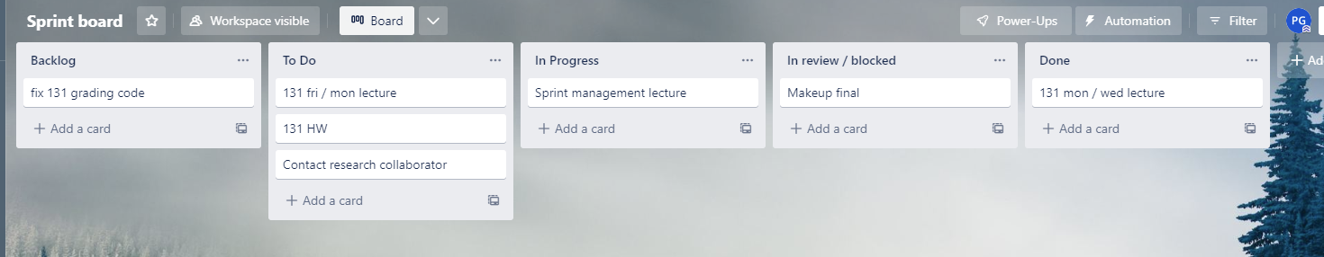
The Sprint Board

Slide 45
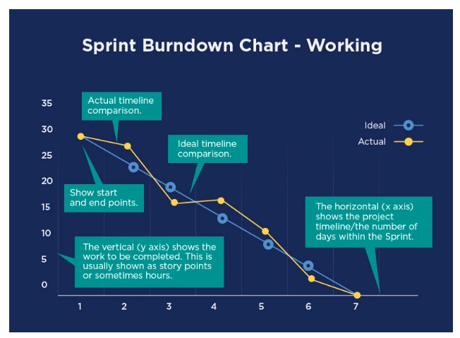
Burn Down Charts
What is a Burndown Chart? (villanovau.com)

Slide 46
Stand-ups
It’s a stand-up, not a sit-down—keep it brief
  “Let’s take it offline”
Can be in-person or async by a certain time of day
  e.g. dedicated slack channel
In 2/3 minutes summarize:
  What you are working on
  What you’ve been doing
  What you are going to do
  Blockers
  Risks
If you can’t just do this, that’s a “smell”
Fun team activity

Slide 47
The Goal—Kanbans
What exactly do I want to have happen?
  Maximize throughput of “low effort” tasks
    Low effort in the sense of not many points, rather than easy
How will I know if it worked?

Slide 48
The Goal—Kanbans
What exactly do I want to have happen?
  Maximize throughput of “low effort” tasks
    Low effort in the sense of not many points, rather than easy
How will I know if it worked?
  Priority queue remains manageable over time

Slide 49
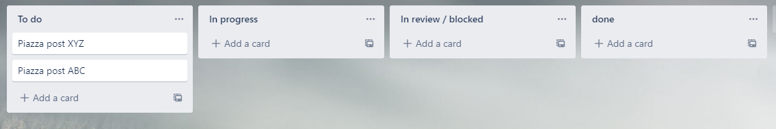
Kanbans
When you’re done with the current ticket, pull the next one off the priority queue
Anyone can do any ticket
No backlog

Slide 50
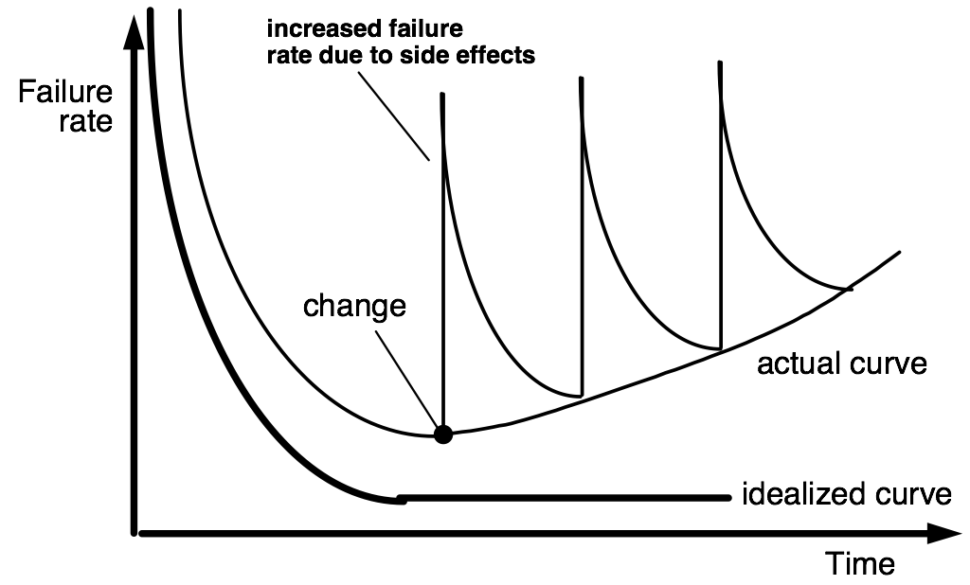
Effort over time
New business cases
Side effects from other projects
Effort
Deployment

Slide 51
Integration and configuration
Based on software reuse where systems are integrated from existing components or application systems (sometimes called COTS -Commercial-off-the-shelf) systems).
Reused elements may be configured to adapt their behaviour and functionality to a user’s requirements
Reuse is now the standard approach for building many types of business system
  Reuse covered in more depth in Chapter 15.

Slide 52
Types of reusable software
Stand-alone application systems (sometimes called COTS) that are configured for use in a particular environment.
Collections of objects that are developed as a package to be integrated with a component framework such as .NET or J2EE.
Web services that are developed according to service standards and which are available for remote invocation.

Slide 53
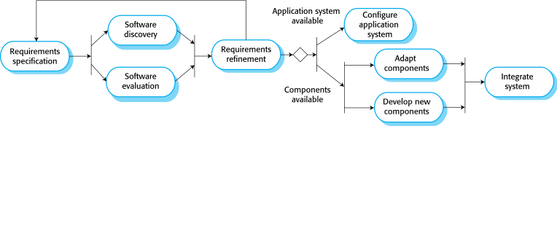
Reuse-oriented software engineering

Slide 54
Advantages and disadvantages
Reduced costs and risks as less software is developed from scratch
Faster delivery and deployment of system
But requirements compromises are inevitable so system may not meet real needs of users
Loss of control over evolution of reused system elements

Slide 55
Incremental delivery
Rather than deliver the system as a single delivery, the development and delivery is broken down into increments with each increment delivering part of the required functionality.
User requirements are prioritised and the highest priority requirements are included in early increments.
Once the development of an increment is started, the requirements are frozen though requirements for later increments can continue to evolve.
30/10/2014
Chapter 2 Software Processes

Slide 56
Incremental development vs delivery
Incremental development
  Develop the system in increments and evaluate each increment before proceeding to the development of the next increment;
  Normal approach used in agile methods;
  Evaluation done by user/customer proxy.
Incremental delivery
  Deploy an increment for use by end-users;
  More realistic evaluation about practical use of software;
  Difficult to implement for replacement systems as increments have less functionality than the system being replaced.
30/10/2014
Chapter 2 Software Processes

Slide 57
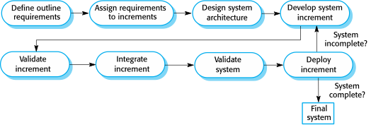
Incremental delivery (to the customer)
30/10/2014
Chapter 2 Software Processes

Slide 58
Incremental delivery advantages
Customer value can be delivered with each increment so system functionality is available earlier.
Early increments act as a prototype to help elicit requirements for later increments.
Lower risk of overall project failure.
The highest priority system services tend to receive the most testing.
30/10/2014
Chapter 2 Software Processes

Slide 59
Incremental delivery problems
Most systems require a set of basic facilities that are used by different parts of the system.
  As requirements are not defined in detail until an increment is to be implemented, it can be hard to identify common facilities that are needed by all increments.
The essence of iterative processes is that the specification is developed in conjunction with the software.
  However, this conflicts with the procurement model of many organizations, where the complete system specification is part of the system development contract.
30/10/2014
Chapter 2 Software Processes

Slide 60
Recap

Slide 61
Bottom line
Software development is a planned activity
We use process to both manage the software development lifecycle (SDLC) activities and to improve the process itself
Each company uses its own SDLC model but all of them are essentially Define, Design, Develop, Deliver, DMaintain
The differences are often of scale and/or concurrency of activities

Slide 63
What is software engineering?
“A systematic approach to the analysis, design, assessment, implementation, test, maintenance and re-engineering of software, that is, the application of engineering to software.”
Software engineering encompasses methodologies and principles related to
Conceiving | Building (meh)
Communicating | Designing
Specifying | Testing
Designing | Maintaining

Slide 64
Benefits are good. Features with no benefit are actively bad
Software doesn’t make money. Deployed artifacts make money

Slide 65
RUP Illustrated
Time
Workflows

Slide 66
The requirements engineering process

Slide 67
Plan-driven vs agile development

Slide 68
The waterfall model
Define, Design, Develop, Deliver

Slide 69
Incremental development

Slide 70
  The extreme programming (XP) release cycle

Slide 71
  The extreme programming (XP) release cycle
`

Slide 72
Scrum sprint cycle

Slide 73
Effort over time
New business cases
Side effects from other projects
Effort
Deployment

Slide 74
Reuse-oriented software engineering

Slide 75
Incremental delivery (to the customer)
30/10/2014
Chapter 2 Software Processes

